Slide 1
Hold the Gold, LLC. presents:
Annual Investors Real Estate Summit
for Washington D.C., 2019
Manisha Gupta
Helen Levy-Myers
Pablo Salcedo

Slide 2

Why Should You Invest in the D.C. Metro Area?
One of the fastest growing metropolitan areas in the country
Steady stream of capital investment inflow
Strategic federal government hub provides increased safety cushion for investment and constant inflow of workers and renters
Upcoming Amazon headquarters in nearby Arlington, Virginia to spur additional demand and growth
Consistently high ranks in livability scores
10/10 GreatSchools rated elementary, middle, and high schools
90-100 Most Competitive Redfin Compete Score
7th most walkable large city in the US (walkscore.com)
71 transit score
Notes:
Assumptions:
You are an investor with a minimum of $100,000 to deploy upfront.
Your time horizon for investment is 5-10 years (this is not a liquid investment).
You seek to maximize growth potential by tapping into home value appreciation in one of America's fastest growing metro areas.
Your threshold for volatility is low (note that no investment is guaranteed and any investment with Hold the Gold is subject to future market conditions).
Redfin Compete Score
Most homes get multiple offers, often with waived contingencies. Homes typically receive 1 offer. Homes sell for around list price and go pending in around 11 days. Hot Homes can sell for about 3% above list price and go pending in around 5 days

Slide 3
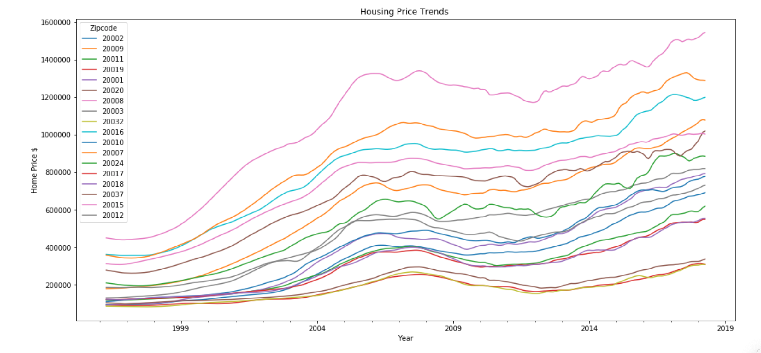
Historical Housing Prices
High value homes
High volatility homes
Medium value homes
Low value homes
Notes:
Groups divided by similar trends

Slide 4
Goal
To find the top zip code for our savvy investors to deploy capital into for maximum financial return (ROI)
4
Notes:
Using Zillow housing data on past home sales in D.C. from 1996-2018

Slide 5
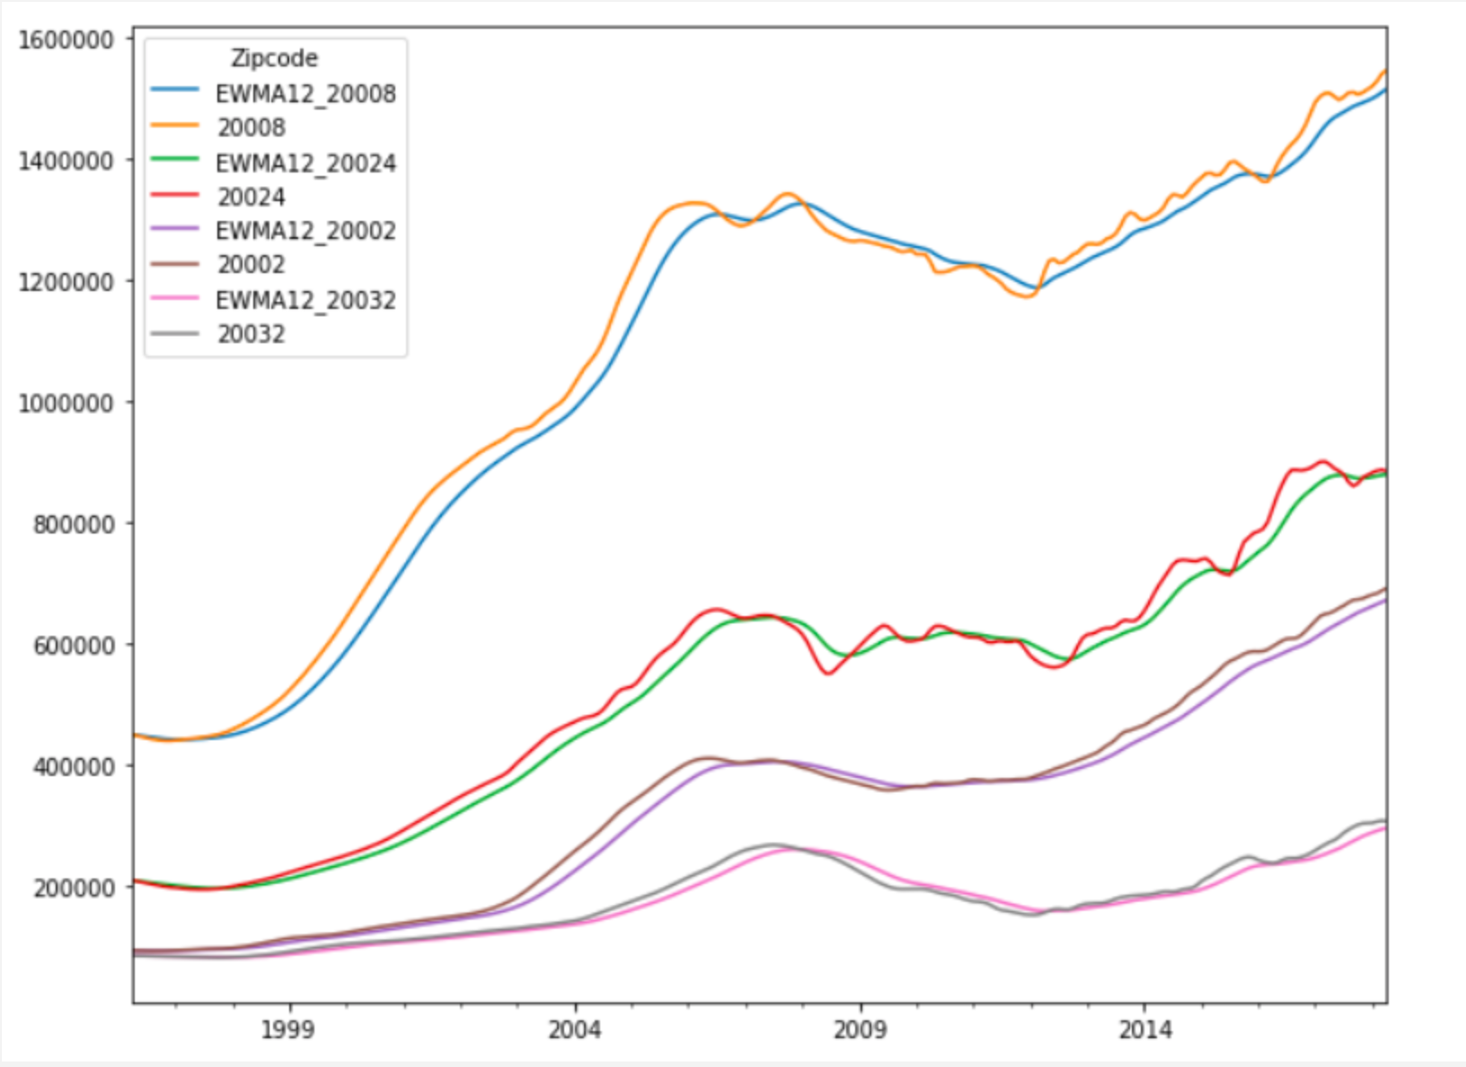
Base Model: Exponentially Weighted Moving Average
Notes:
First started with our naïve model -

Slide 6
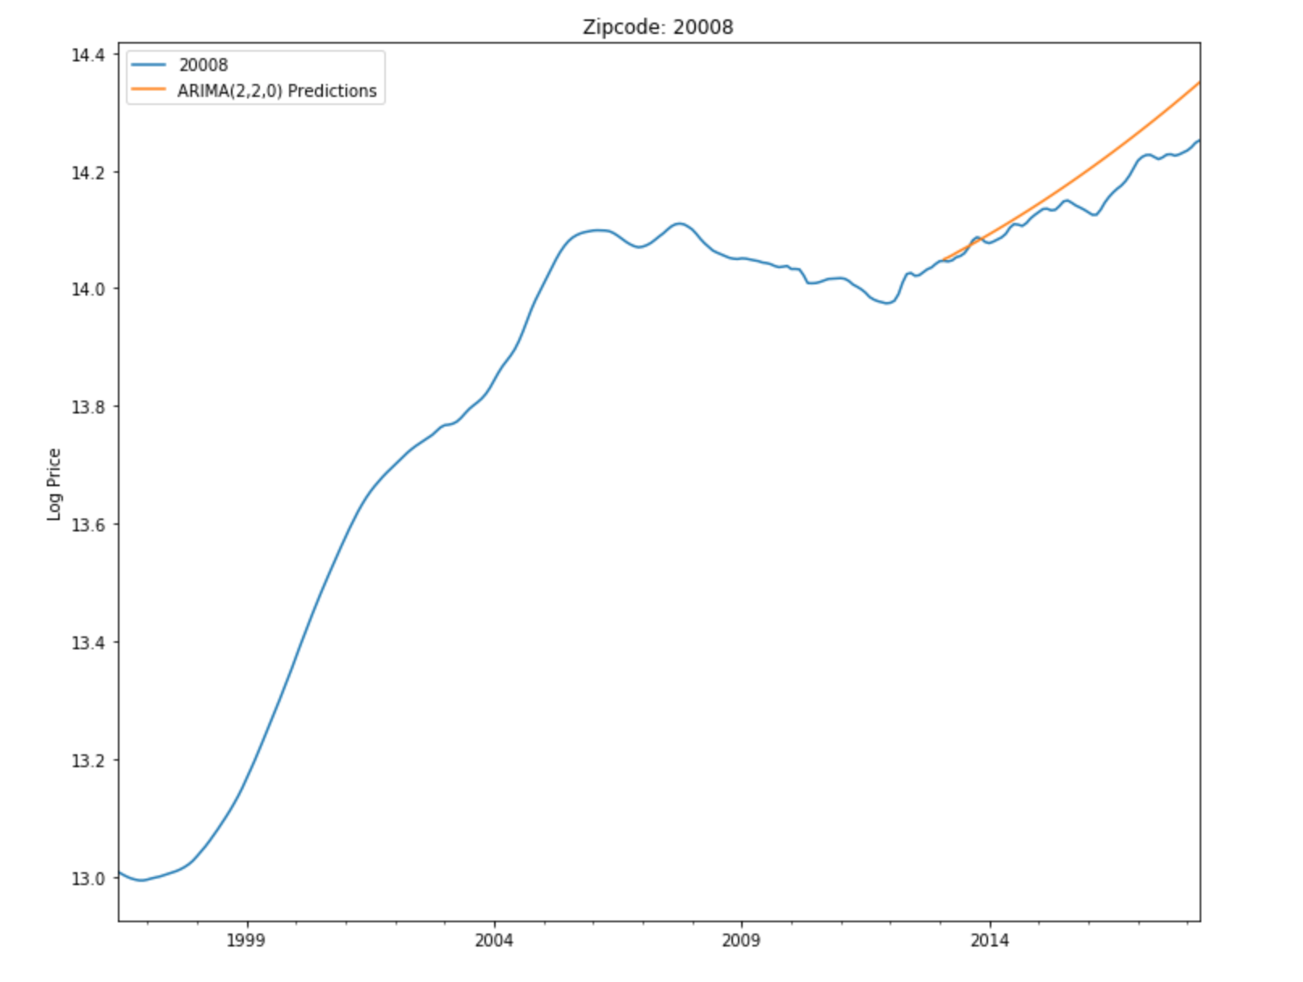
Predicted Prices for High Value Zip codes
MSE Error: 0.003
RMSE Error: 0.054
Notes:
Used predictive modeling to predict future housing price trends among 18 D.C. zip codes
Based on our model, the top 3 zip codes were selected based on predicted ROI(increase in price from time of purchase)
We utilized historical Zillow home price data for the 18 zip codes, we tested the accuracy of our predictive model in 4 zip code categories
Using the historical data provided, we tested the extent to which we could accurately predict prices in each of our 4 zip code categories for the last 5 years (2013-2018). Here you will see the

Slide 7
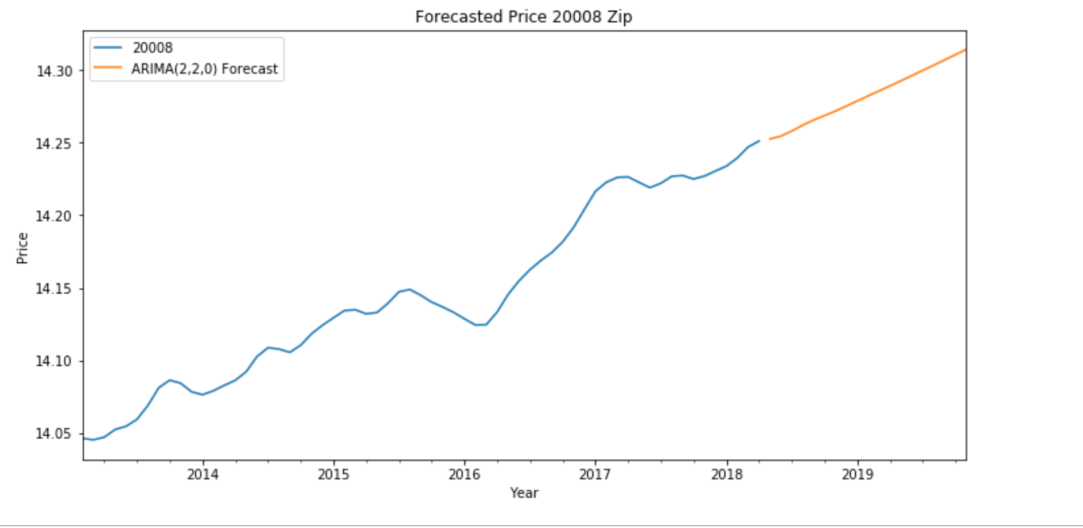
Forecasted Prices for High Value Zip Codes
Notes:
Using the historical data provided, we tested the extent to which we could accurately predict the average value of home sales in each of our 4 zip code categories for the past 5 years, and then used forecasting to predict home future sale trends for each. Here we have pictured the forecasted prices for our recommended zip codes (high value group).
The higher up the y axis, the higher the value?

Slide 8
Top 3 Zip Codes to Purchase Real Estate:
From our analysis, the high performance group consisting of zip codes
20008, 20007, 20016 are the best zip codes to invest in.
20008
20007
20016

Slide 9

Thank you for choosing Hold the Gold, LLC.

